Slide 1
N. Rizk
COSC 3337 : Data Science I
College of Natural and Applied Sciences
Department of Computer Science
University of Houston

Slide 2
Gradient descent
pick a starting point (w)
repeat until loss doesn’t decrease in all dimensions:
pick a dimension
move a small amount in that dimension towards decreasing loss (using the derivative)

Slide 3

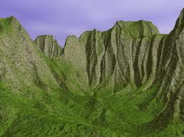
Finding the minimum
You’re blindfolded, but you can see out of the bottom of the blindfold to the ground right by your feet. I drop you off somewhere and tell you that you’re in a convex shaped valley and escape is at the bottom/minimum. How do you get out?

Slide 4
Gradient descent
pick a starting point (w)
repeat until loss doesn’t decrease in all dimensions:
pick a dimension
move a small amount in that dimension towards decreasing loss (using the derivative)

Slide 5
Some maths

Slide 6
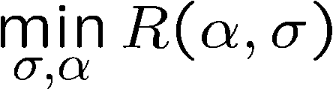
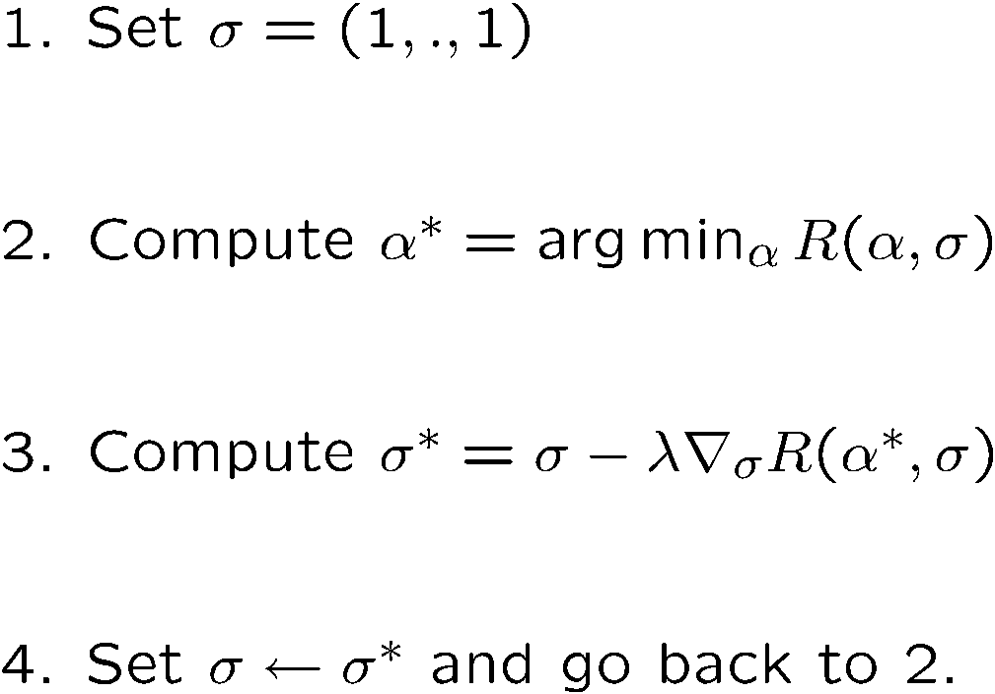
Gradient descent
How to minimize ?
Most approaches use the following method:
Would it make sense to perform just a gradient step here too?
Gradient step in [0,1]^{n}.

Slide 7
Gradient descent summary
Many algorithms can be turned into embedded methods for feature selections by using the following approach:
Choose an objective function that measure how well the model returned by the algorithm performs
Differentiate this objective function according to the σ parameter
Performs a gradient descent on σ. At each iteration, rerun the initial learning algorithm to compute its solution on the new scaled feature space.
Stop when no more changes (or early stopping, etc.)
Threshold values to get list of features and retrain algorithm on the subset of features.
Difference from add/remove approach is the search strategy. It still uses the inner structure of the learning model but it scales features rather than selecting them.

Slide 8
Gradient descent
Advantage of this approach:
can be done for non-linear systems (e.g. SVM with Gaussian kernels)
can mix the search for features with the search for an optimal regularization parameters and/or other kernel parameters.
Drawback:
heavy computations
back to gradient based machine algorithms (early stopping, initialization, etc.)
(all training observations utilized in each iteration)

Slide 9
Stochastic Gradient Descent
Solution :one observation per iterations
(SGD) is a simple (select samples not all data) yet very efficient approach to discriminative learning of linear classifiers under convex loss functions such as (linear)
Support vector machine
And logistic regression

Slide 10
Advantage /Disadvantage
The advantages of Stochastic Gradient Descent are:
Efficiency.
Ease of implementation (lots of opportunities for code tuning).
The disadvantages of Stochastic Gradient Descent include:
SGD requires a number of hyperparameters such as the regularization parameter and the number of iterations.
SGD is sensitive to feature scaling.

Slide 11
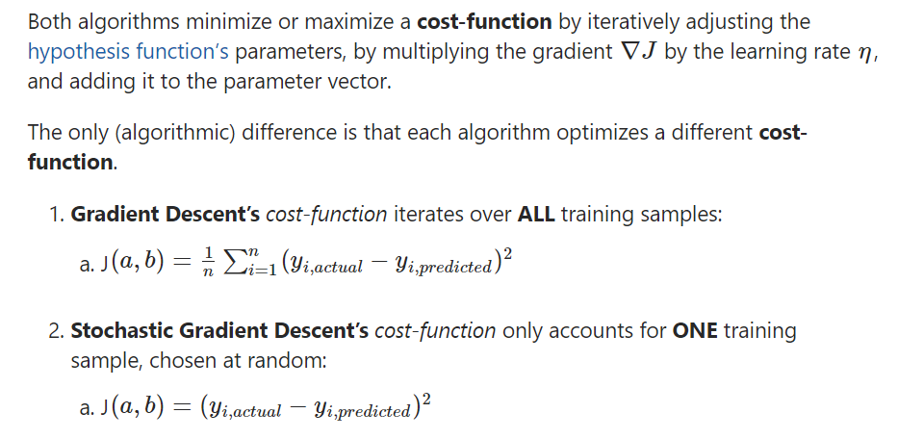
GD vs SGD

Slide 12
cost functions
Cost functions referred to by different names: loss function, or error function, or scoring function.
Consider linear regression, where we choose mean squared error (MSE) as our cost function. Our goal is to find a way to minimize the MSE.
Our final goal, however, is to use a cost function so we can learn something from our data.

Slide 13
Using gradient ascent for linear classifiers
Key idea :
Define a linear classifier (logistic regression)
Define an objective function (likelihood)
Optimize it with gradient descent to learn parameters
Predict the class with highest probability under the model

Slide 14
Create a learning process
we’re going to be implementing gradient descent to create a learning process with feedback.
Each time — each step really — we receive some new information, we’re going to make some updates to our estimated parameter which move towards an optimal combination of parameters.
We get these estimates using our cost function from before.

Slide 15
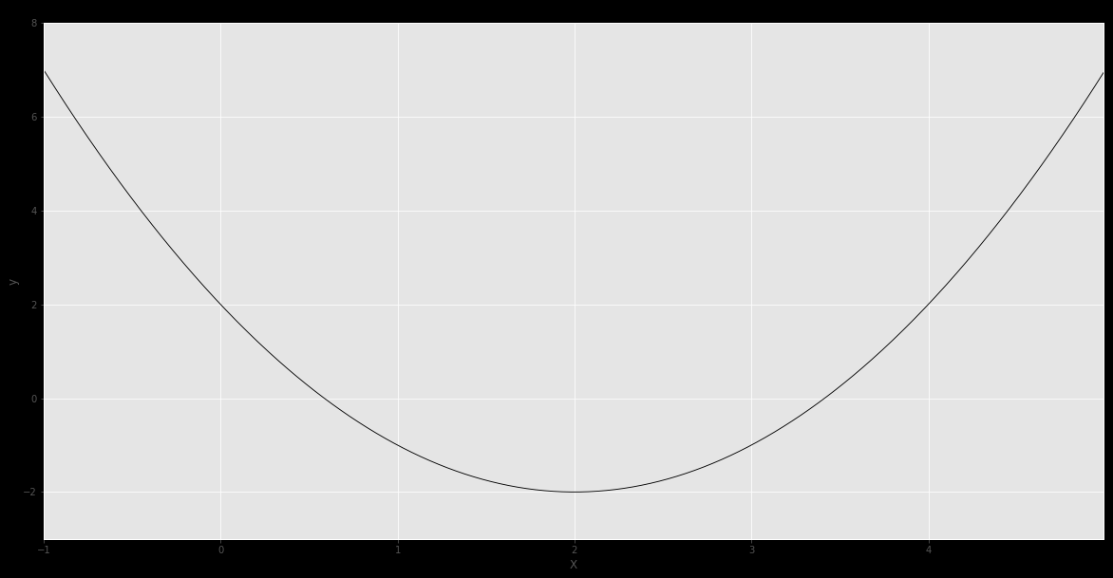
# Finding the minimum of the function y = x^2 - 4x + 2 dy/dx = 0 = 2*x - 4 # This is our cost function x = 2
#

Slide 16
How would we find the solution using gradient descent?
Let’s break this down mathematically, as we’re going to be estimating a parameter θ which we will substitute for x. θ is the value we’re going to update after every step and will tell us what the current value of x is through minimization process. As θ converges to the minimum using our cost function.
However, we don’t always know were to start θ on our cost function so we take a guess. It starts at this guessed point somewhere along the cost function, and descends towards the actual value.
That is the descent, in gradient descent.
We are also going to introduce a variable called α which is out learning rate.
The learning rate tells our cost function how fast to move toward its goal

Slide 17
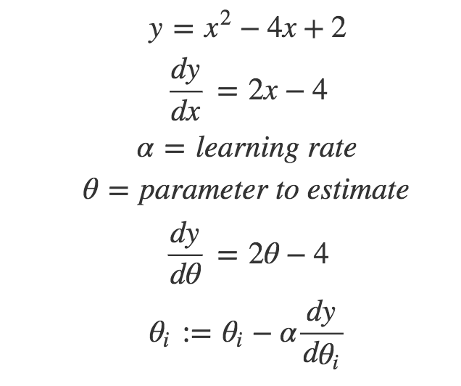
def func_y(x):
y = x**2 - 4*x + 2
return y
def gradient_descent(previous_x, learning_rate, epoch):
# To fill with values
x_gd = []
y_gd = []
x_gd.append(previous_x)
y_gd.append(func_y(previous_x))
# begin the loops to update x and y with out cost function
for i in range(epoch):
current_x = previous_x - learning_rate * (2*previous_x - 4)
x_gd.append(current_x)
y_gd.append(func_y(current_x))
# update previous_x
previous_x = current_x
return x_gd, y_gd
# Initialize x0 and learning rate
x0 = 4 # Our first 'guess' at what theta could be
learning_rate = 0.15 # Alpha
epoch = 10 # Number of tries

Slide 18
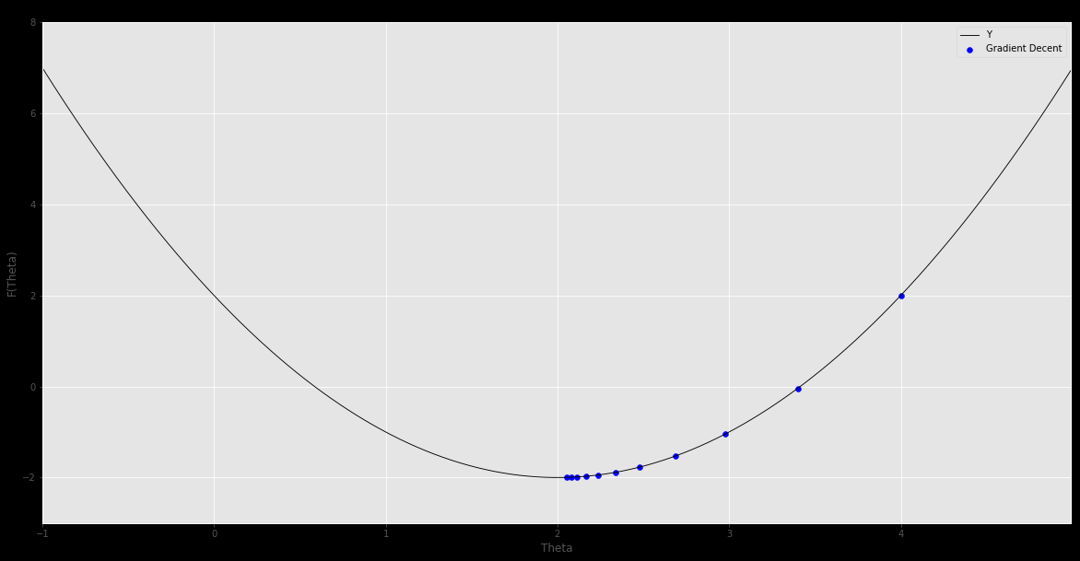
START AT 4

Slide 19
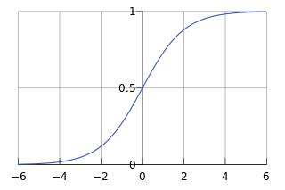
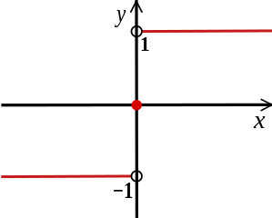
Using gradient ascent for linear classifiers
This decision function isn’t differentiable:
Use a differentiable function instead:
sign(x)

Slide 20
Using gradient ascent for linear classifiers
This decision function isn’t differentiable:
Use a differentiable function instead:
sign(x)

Slide 21
Logistic Regression
Data: Inputs are continuous vectors of length K. Outputs are discrete.
Model: Logistic function applied to dot product of parameters with input vector.
Learning: finds the parameters that minimize some objective function.
Prediction: Output is the most probable class.

Slide 22
Speeding logistic regression using SGD
The class SGDClassifier implements a plain stochastic gradient descent
learning routine which supports different loss functions and penalties for
classification.
As other classifiers, SGD has to be fitted with two arrays: an array X of size [n_samples, n_features] holding the training samples, and an array Y of size [n_samples] holding the target values (class labels) for the training samples:
from sklearn.linear_model import SGDClassifier
X = [[0., 0.], [1., 1.]]
y = [0, 1]
clf = SGDClassifier(loss="hinge", penalty="l2", max_iter=5)
clf.fit(X, y)
SGDClassifier(alpha=0.0001, average=False, class_weight=None,
early_stopping=False, epsilon=0.1, eta0=0.0, fit_intercept=True,
l1_ratio=0.15, learning_rate='optimal', loss='hinge', max_iter=5,
n_iter=None, n_iter_no_change=5, n_jobs=None, penalty='l2',
power_t=0.5, random_state=None, shuffle=True, tol=None,
validation_fraction=0.1, verbose=0, warm_start=False)

Slide 23
After being fitted, the model can then be used to predict new values:
>>> clf.predict([[2., 2.]])
array([1])
#SGD fits a linear model to the training data. The member coef_ holds the model parameters:
>>> clf.coef_
array([[9.9..., 9.9...]]) #Member intercept_ holds the intercept
>>> clf.intercept_
array([-9.9...])

Slide 24
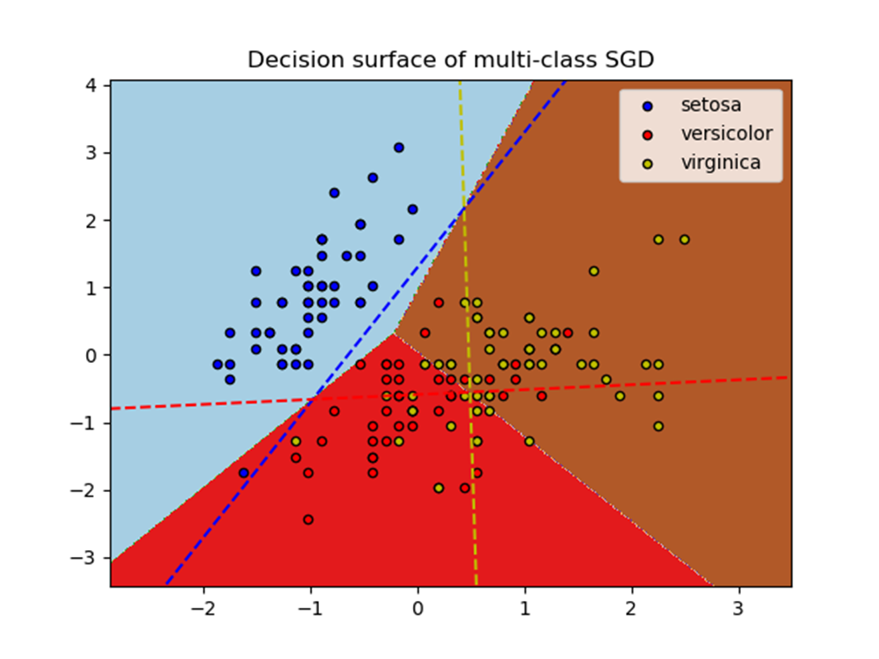
decision
To get the signed distance to the hyperplane use SGDClassifier.decision_function:
>>> clf.decision_function([[2., 2.]])
array([29.6...])
The concrete loss function can be set via the loss parameter.
SGDClassifier supports the following loss functions:
loss="hinge": (soft-margin) linear Support Vector Machine,
loss="modified_huber": smoothed hinge loss,
loss="log": logistic regression,

Slide 25
Using loss="log" or loss="modified_huber" enables the predict_proba method, which gives a vector of probability estimates per sample :
>>> clf = SGDClassifier(loss="log", max_iter=5).fit(X, y)
>>> clf.predict_proba([[1., 1.]])
array([[0.00..., 0.99...]])

Slide 26
The concrete penalty can be set via the penalty parameter. SGD supports the following penalties:
penalty="l2": L2 norm penalty on coef_.
penalty="l1": L1 norm penalty on coef_.
penalty="elasticnet": Convex combination of L2 and L1; (1 - l1_ratio) * L2 + l1_ratio * L1.

Slide 27
import numpy as np
import matplotlib.pyplot as plt
from sklearn import datasets
from sklearn.linear_model import SGDClassifier
# import some data to play with
iris = datasets.load_iris()
# we only take the first two features. We could
# avoid this ugly slicing by using a two-dim dataset
X = iris.data[:, :2]
y = iris.target
colors = "bry"
# shuffle
idx = np.arange(X.shape[0])
np.random.seed(13)
np.random.shuffle(idx)
X = X[idx]
y = y[idx]
# standardize
mean = X.mean(axis=0)
std = X.std(axis=0)
X = (X - mean) / std
h = .02 # step size in the mesh
clf = SGDClassifier(alpha=0.001, max_iter=100).fit(X, y)
# create a mesh to plot in
x_min, x_max = X[:, 0].min() - 1, X[:, 0].max() + 1
y_min, y_max = X[:, 1].min() - 1, X[:, 1].max() + 1
xx, yy = np.meshgrid(np.arange(x_min, x_max, h),
np.arange(y_min, y_max, h))

Slide 28
# Plot the decision boundary. For that, we will assign a color to each
# point in the mesh [x_min, x_max]x[y_min, y_max].
Z = clf.predict(np.c_[xx.ravel(), yy.ravel()])
# Put the result into a color plot
Z = Z.reshape(xx.shape)
cs = plt.contourf(xx, yy, Z, cmap=plt.cm.Paired)
plt.axis('tight')
# Plot also the training points
for i, color in zip(clf.classes_, colors):
idx = np.where(y == i)
plt.scatter(X[idx, 0], X[idx, 1], c=color, label=iris.target_names[i],
cmap=plt.cm.Paired, edgecolor='black', s=20)
plt.title("Decision surface of multi-class SGD")
plt.axis('tight')
# Plot the three one-against-all classifiers
xmin, xmax = plt.xlim()
ymin, ymax = plt.ylim()
coef = clf.coef_
intercept = clf.intercept_
def plot_hyperplane(c, color):
def line(x0):
return (-(x0 * coef[c, 0]) - intercept[c]) / coef[c, 1]
plt.plot([xmin, xmax], [line(xmin), line(xmax)],
ls="--", color=color)
for i, color in zip(clf.classes_, colors):
plot_hyperplane(i, color)
plt.legend()
plt.show()

